Slide 1



JDI Dark (HTTP)

Slide 2
JDI Dark
JDI Dark - Simple Web Services Test Automation Framework powered by Rest Assured
Simple Service Objects description
Simple response validations
Load/Performance testing
Use Entity Driven approach
BDD integration for manual team

Slide 3
JDI HTTP
@ServiceDomain("http://httpbin.org/")
public class UserService {
@GET("/get") static RestMethod getUser;
@POST("/post") RestMethod updateSettings;
@PUT("/put") RestMethod addUser;
@PATCH("/patch") RestMethod patch;
@DELETE("/delete") RestMethod removeUser;

Slide 4
JDI HTTP
@ServiceDomain("http://httpbin.org/")
public class UserService {
@GET("/get") static M getUser;
@POST("/post") M updateSettings;
@PUT("/put") M addUser;
@PATCH("/patch") M patch;
@DELETE("/delete") M removeUser;

Slide 5
JDI HTTP
@ServiceDomain("http://httpbin.org/")
public class UserService {
@ContentType(JSON)
@Headers({
@Header(name = "Name", value = "Roman"),
@Header(name = "Id", value = "Test")
}) @GET("/get") M getUser;

Slide 6
SWAGGER/wsdl TO JDI PO
@ServiceDomain("http://httpbin.org/")
public class ServiceExample {
@ContentType(JSON) @GET("/get/{projectId}/{userId}")
@Headers({
@Header(name = "Name", value = "Roman"),
@Header(name = "Id", value = "Test")
})
static RestMethod<Info> getInfo;
@Header(name = "Type", value = "Test") @POST("/post")
RestMethod postMethod;
@PUT("/put") RestMethod putMethod;
@PATCH("/patch") RestMethod patch;
@DELETE("/delete") RestMethod delete;
@GET("/status/%s") RestMethod status;
@BeforeSuite
public static void beforeSuite() {
init(ServiceExample.class);
….
}

Slide 7
SIMPLE SERVICE TEST
@Test
public void statusTest() {
RestResponse resp = service.status.call("503");
resp.isStatus(SERVER_ERROR); //resp.isOk();
assertEquals(resp.status.code, 503);
assertEquals(resp.status.type, SERVER_ERROR);
resp.isEmpty();
}
@Test
public void htmlBodyParseTest() {
RestResponse responce = service.getBook.call();
response.isOk().body("name",
equalTo("Herman Melville - Moby-Dick“));
}

Slide 8
SERVICE RESPONSE
UserService.addUser.call();
RestResponse resp = getUser.call();
assertEquals(resp.status, 200);
assertEquals(resp.statusType, OK);
assertEquals(resp.body(“name"), “Roman");
resp.assertThat().body("url", equalTo("http://httpbin.org/get"))
resp.assertThat().header("Connection", "keep-alive");

Slide 9
ENTITIES
@ServiceDomain ("http://httpbin.org/")
public class UserService {
@GET ("/get") RestMethod<User> getUser;
@PUT ("/put") RestMethod<User> addUser;
Entities
app.addUser.send(user);
User actualUser = app.getUser.asData(User.class);
assertEquals(actualUser, user);

Slide 10
Entity Driven TESTING
@Test
public void entityTest() {
Info info = getInfo.asData(Info.class);
assertEquals(info.url, "http://httpbin.org/get");
assertEquals(info.headers.Host, "httpbin.org");
assertEquals(info.headers.Id, "Test");
assertEquals(info.headers.Name, "Roman");
}

Slide 11
SIMPLE PERFORMANCE TESING
@Test
public void isAliveTest() {
anyMethod.isAlive());
}
@Test
public void simplePerformanceTest() {
PerformanceResult pr = loadService(3600, getInfo);
System.out.println("Average time: " + pr.AverageResponseTime + "ms");
System.out.println("Requests amount: " + pr.NumberOfRequests);
Assert.assertTrue(pr.NoFails(), "Number of fails: " + pr.NumberOfFails);
}

Slide 12
SERVICES TESTING BDD FOR MANUAL QA AND ANALYSTS

Slide 13
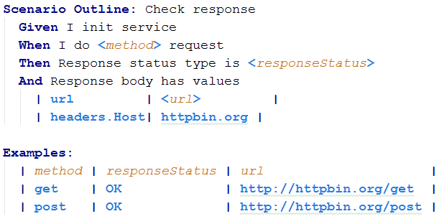
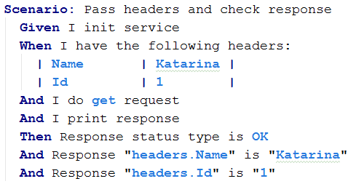
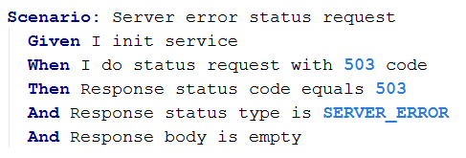
BDD SERVICE TESTS
RUN TESTS

Slide 14
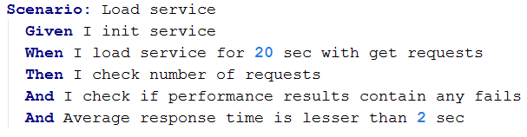
BDD PERFORMANCE TESTS

Slide 15


Services testing framework
Obvious Service object model
Simple interface for requests sending and response analysis
Support performance testing
Detailed logging on User language with no effort
BDD approach native support
Include all RestAssured features
Increase Services tests development speed
Decrease effort on test runs results analysis
Allow to write and execute automated tests for services for Manual QA
https://github.com/jdi-testing/jdi-http

Slide 16


CHANGE THE WORLD
https://github.com/epam/jdi
JDI original
Since 2015
https://github.com/jdi-testing/jdi-2.0
JDI 2.0
Autumn 2017
https://github.com/jdi-testing/jdi-light
JDI Light
Spring 2018
https://github.com/jdi-testing/jdi-http
JDI Dark
https://github.com/jdi-testing
https://github.com/jdi-templates

Slide 17
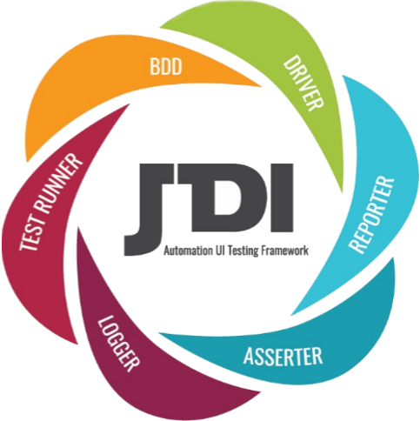



Q & A
&
Contacts
roman.Iovlev
Roman.Iovlev.jdi@gmail.com

